Slide 1


Teacher Made Test: Construction Process
Creating a successful teacher-made test involves thoughtful planning and careful preparation. In this presentation, we will explore the step-by-step process of constructing a high-quality examination that accurately reflects student learning.
Presentation by : Dhiraj Kumar Shah
Symbol no:7621009

Slide 2

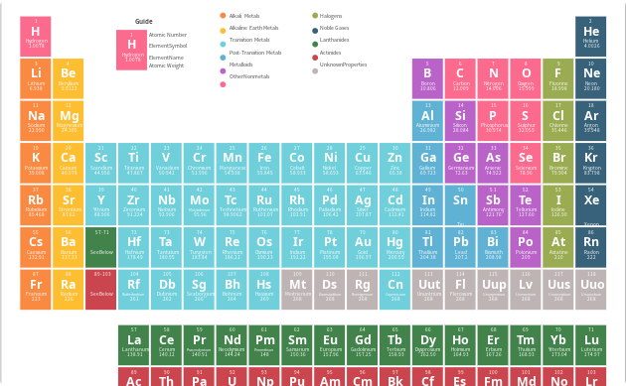
Planning the Test
Writing Instructional Objectives
Preparing Specification Chart
The first step in constructing a successful teacher-made test is to clearly define the learning objectives and outcomes that the assessment will measure. This must be done before preparing the actual test items.
A specification chart outlines the topics, concepts, and learning objectives that will be included in the assessment. It serves as a blueprint for constructing the test items and ensures coverage of important content areas.

Slide 3
Writing Strong Instructional Objectives
Be Specific
Use Action Verbs
Clearly define what students should know or be able to do.
Start each objective with a clear, measurable action verb.
Be Realistic
Assess What You Teach
Make sure the objective is achievable given the time and resources provided.
Focus on key concepts and skills that you have taught or will teach.

Slide 4




Preparing a detailed Specification Chart
Test Type
Timing
Scoring
Multiple Choice? Short Answer? Essay?
How long will students have to complete the test?
How many points is each question worth? What grading criteria will you use?
Content
What concepts/skills will be assessed? What materials/references may students use?

Slide 5
Understanding Bloom's Taxonomy
1
2
3
4
5
6
Remembering
Understanding
Applying
Analyzing
Evaluating
Creating
Recall factual information
Explain ideas or concepts, show relationships
Use information in a new situation
Examine parts and relationships between them
Judge the value of information based on criteria
Combine information to form a new whole

Slide 6

Writing Good Test Questions
1
Be Clear
Avoid ambiguity, ensure that the question is easy to understand.
2
Avoid Tricks
Avoid negative phrasing, double negatives, or other confusing language.
3
Be Fair
Ensure that the question is appropriate to the students' level of ability and the content of the course.
4
Cover Important Topics
Ensure that the test is comprehensive and covers key topics from the course.

Slide 7
Grading and Assessment
Traditional
Standards Based
Assign points to each question and add up the total to determine the grade
Set specific learning goals and assign grades based on how well students meet those goals

Slide 8
Using Test Results
1
Diagnostic Information
Analyze results to find individual and collective areas of weakness.
2
Planning for the Future
Use results to inform future lessons and improve assessments.
3
Celebrate Success
Highlight individual and collective successes to acknowledge hard work and growth.

Slide 9
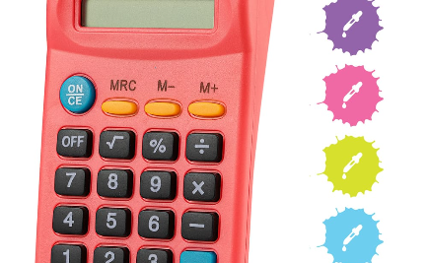


Common Errors To Avoid
Math Errors
Spelling and Grammar Mistakes
Overcomplicating the Test
Ensure that your calculations are accurate and that you use the correct units of measurement.
Be sure to proofread your questions and answers to ensure that they are clear and error-free.
Keep the test reasonable and focused on key concepts. Avoid using obscure or irrelevant material.

Slide 10
Preparing the Test
Preparing Test Items
Preparing Instructions
Preparing Scoring Key and Marking Scheme
Test items should be designed to accurately measure student learning outcomes and assess higher-order thinking skills. Writing test questions requires careful attention to detail and proper selection of item types and levels of difficulty.
Clear and concise instructions help students understand the purpose of the test and how to answer questions. The instructions should provide details about test format, timing, and scoring.
The scoring key and marking scheme should be developed to ensure that scores are reliable, valid, and aligned with instructional objectives. Rubrics may be used to provide detailed feedback to students on their performance.

Slide 11
Test Security
Preventing Cheating
Test security measures should be implemented to prevent cheating, such as seating arrangements, monitoring, and use of different forms of the test.
1
2
3
Confidentiality
Proper Storage
It is important to maintain the confidentiality of test items and the test itself. Students should not have access to the test before the scheduled administration time.
Tests should be properly stored before and after administration to prevent access by unauthorized persons. Electronic files should be password protected and secure.

Slide 12



Test Analysis and Review
Analysis
Review
After the test is administered and scored, the results must be analyzed to evaluate student learning and the effectiveness of the test. This data can be used to improve teaching and learning.
The test review process allows students to review their performance and understand feedback on their learning. Teachers can use this process to discuss student weaknesses and strengths and adjust instruction accordingly.

Slide 13
Alternatives to Traditional Tests
Authentic Assessment
Formative Assessment
Performance-based assessments such as projects and portfolios can provide a more comprehensive view of student learning and improve intrinsic motivation.
Frequent, ongoing assessments such as quizzes and exit tickets can be used to monitor student learning progress and adjust instruction accordingly.
Self-Assessment
Peer Assessment
Self-reflection activities can help students take ownership of their learning and deepen understanding of their strengths and weaknesses.
Peer evaluation and collaboration activities can help to promote critical thinking, communication, and social skills.

Slide 14

Conclusion
The process of constructing a high-quality teacher-made test can seem daunting, but with careful planning and preparation, it can be an effective tool for measuring student learning outcomes. Remember to consider test security, analysis, and alternative assessment strategies to improve student learning.

